Slide 1
Principal stratification application in vaccine trials
LDS Summer Intern Program 2024
Wei Wang, Bing Liu, Rong Fu, Yujing Gao
May 24, 2024

Slide 2
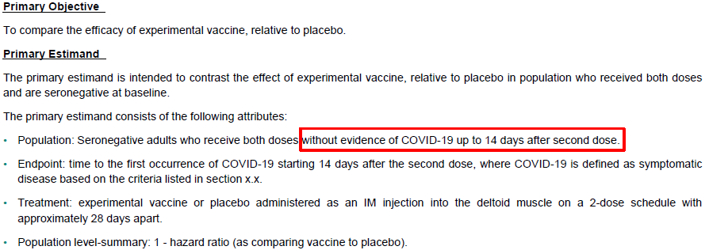
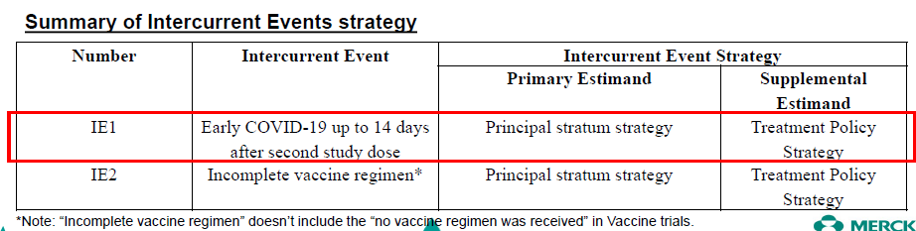
Estimand in Vaccine Efficacy Objective : Intercurrent Events Handling (ELSTIC Training)
Example: Time to the first occurrence of COVID (Time to Event)
o define a causal vaccine efficacy estimand

Slide 3
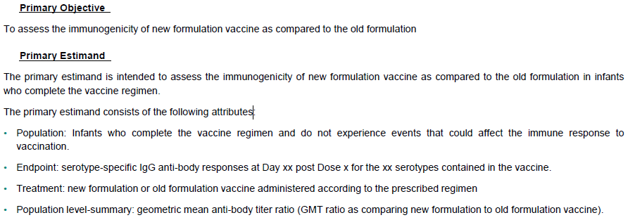
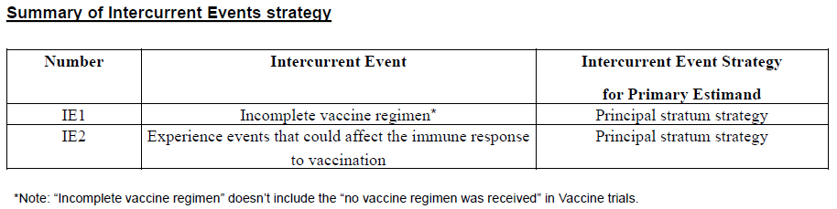
Estimand in Vaccine Immunogenicity Objective : Intercurrent Events Handling (ELSTIC Training)
Example: Non-inferiority of new formulation to old formulation

Slide 4
1. Per-Protocol Analysis vs. Principal Stratum Strategy Analysis
RV144 HIV vaccine trials: randomized, placebo-controlled, to assess the vaccine efficacy (VE) against HIV infection = 1 – HR (vaccine vs. placebo)
HIV vaccination/placebo administration at Day 0, Weeks 4, 12, and 24
Analysis population | Definition | VE Results | Note
Modified-intention to treat (MITT) | All randomized subjects HIV negative at baseline | 31% (95% CI: 0% to 51%; p = 0.04) | Causal effect estimate Treatment policy strategy: vaccine effect if pts were assigned vaccine compared to if were assigned to placebo
Per-protocol (PP) | A subset of MITT who were also HIV negative at Week 24 and received all 6 study injections within pre-specified allowable visit windows | 25% (95% CI: -16% to 51%; p=0.19) | Not necessarily a causal effect estimate (as in a subset whose membership determined by post-randomization variables) ?Principal stratum strategy: vaccine effect among participants who would comply to the assigned immunization and HIV-naïve up to Week 24
Notes:
Current practice: To use the same method employed for the intentionto-treat analysis applied to the subgroup meeting protocol adherence criteria (i.e., per-protocol analysis)
PP: it assesses a mixture of the effect of vaccine assignment and imbalanced prognostic factors created by conditioning on qualification into the PP cohort.

Slide 5
Estimands under Principal Stratum Strategy (Gilbert et al. 2013)
Notations:
Treatment group: Z = 1 (vaccine) or 0 (placebo)
Primary time-to-event endpoint: X = min(T, C) and Δ = I(T ≤ C)
Intercurrent events:
Indicator of adherence to assigned treatment up to time τ0 (e.g., one-month post last vaccination): A = 1 or 0 (A undefined if T ≤ τ0, denoted by A = *) -> principal stratum: {T(z) > τ0}, z=0,1
Disease-free up to time τ0 (i.e., early disease): T > τ0 -> principal stratum: {A(z) = 0}, z=0,1
Three estimands of interest:
In always-per-protocol (APP) subjects: {T(1) > τ0, A(1) = 1; T(0) > τ0, A(0) = 1} (pts who would survive to τ0 under both treatments and would adherent to whatever they were assigned)
In always-survivors always-compliant to treatment 1 (ASA1): {T(1) > τ0, A(1) = 1; T(0) > τ0} (pts who would survive to τ0 under both treatments and adherent to treatment 1, regardless of whether they would adhere to treatment 0)
In per-protocol to treatment 1 (PP1): {T(1) > τ0, A(1) = 1} (pts who would survive to τ0 under treatment 1 and adherent to treatment 1)
Notes:
ASA1: This subpopulation is of interest because, once a treatment is licensed, treatment decisions and policies will largely be based on the predicted effect of that treatment for those who take it, whereas adherence to a control preparation may no longer be relevant.

Slide 6
Assumptions and Estimations (Gilbert et al. 2013)
Basic assumptions:
Stable Unit Treatment Values (SUTVA): potential outcomes for each subject i are unrelated to the assignment Zj of other subjects and that there are not multiple versions of treatment
Ignorable Treatment Assignment: Z ⊥ (T(1), T(0), C(1), C(0), A(1), A(0)), and random Censoring (T(z) ⊥ C(z) for z = 0, 1)
Other identifiability assumptions:
Survival Monotonicity (SM): P(T(1) ≤ τ0 < T(0)) = 0 (pts who would survive beyond τ0 if assigned Z = 0 would also survive beyond τ0 if assigned Z = 1; e.g. placebo-controlled trials, non-inferiority trials)
Adherence Monotonicity (AM): P(A(1) = 1, A(0) = 0|T(1) > τ0, T(0) > τ0) = 0 (among pts surviving beyond τ0 under both assignments, those who would adhere under assignment Z = 1 would also adhere under assignment Z = 0; e.g., double-blinded trial where side effects are as or more likely for Z = 1 than for Z = 0)
Equal Adherence (EA): P(A(1) = A(0)|T(1) > τ0, T(0) > τ0) = 1 (all subjects retained and adherent under one assignment would also be so under the other; e.g. double-blinded non-toxic interventions in healthy populations)
Estimation of each principal stratum estimand : semiparametric modeling approach to sensitivity analysis under 4 types of assumption sets (increasingly stringent): (A) Base set, (B) Base set plus AM, (C) Base set plus (SM, AM), (D) Base set plus (SM, EA)
Use a fixed sensitivity parameter γ to model the probability of being in a principal stratum
Non-parametric bonds for the estimate over a selected region of γ
Could consider
What kind of accompanied assessment of assumption could be done based on observed data (however, cannot be fully verified) (e.g., SM is rejected if a test indicates S1(τ0) < S0(τ0) in any baseline subgroup)
Whether the observed imbalance could be quantified and then used to advice when a PP analysis is reasonably good

Slide 7
2. Vaccine Effect in Post-infection outcomes: Principal Effect
Question: To assess the vaccine effects concerning post-infection outcomes, such as severe disease, death, or transmission to others (most popular in HIV vaccine trials for assessing the vaccine effect in reducing viral load post HIV-infection)
Two main approaches commonly applied:
Alternative approach: principal stratification approach to estimate the principal effect that is causal
Gilbert et al. (2003): continuous post-infection outcomes, hypothesis testing
Hudgens et al. (2006): binary post-infection outcomes, estimation (e.g., VE as relative reduction in attack rate)
 | Approach | Note
1 | To include all participants, regardless if they become infected or not (i.e., ITT principle) | Statistical validity associated with ITT principle Does not distinguish effects on susceptibility to infection from effects on the postinfection endpoints of interest May be less sensitive in detecting postinfection vaccine effects than an analysis that conditions on infection
2 | To include only participants who become infected (i.e., net effect) | May result in selection bias as conditioning on a post-randomization event (who become infected if vaccinated is likely not identical to those who would become infected if given control) May include “infection” as an adjustment variable
The “Principal Effect” may be less popular than “ITT Effect” in VE against severe disease or mortality in real practice.
However, can it be related to the estimand under the principal stratum strategy w.r.t. the intercurrent event of “early disease”?

Slide 8
Estimands (Hudgens et al. 2006)
Notations:
Treatment group: Z = 1 (vaccine) or 0 (placebo)
Infection status outcome: S(Z) = 1 or 0 -> principal stratum: {S(1)=1, S(0)=1}
Primary postinfection endpoint: Y(Z,S) = 1 or 0, if S(Z)=1; Y(Z,S) = * undefined if S(Z)=0
Estimand of interest:
VE in doomed subjects: {S(1)=0, S(0)=0} (pts who would become infected whether vaccinated or not)
Basic assumptions:
Stable Unit Treatment Values (SUTVA)
Ignorable Treatment Assignment: Z is independent of {Y(1), Y(0), S(1), S(0)}
Monotonicity: P(S(1)=1, S(0)=0) = 0 (an individual who would become infected under vaccine also would become infected under placebo, i.e., vaccine effect on infection is non-negative)
Other identifiability assumptions:
No selection bias: Y(0)|S(0)=1 ⊥ S(1) (the probability of postinfection outcome conditional on infection under placebo is independent of infection status under vaccine; i.e. net effect eq. principal effect)
Extreme selection bias: (upper bound) all placebo recipients in the doomed principal stratum have the worse postinfection outcome or all placebo recipients in the protected principal stratum have the better postinfection outcome; (lower bound) under assignment to placebo, the worse postinfection outcome occurs either with probability 0 in the doomed principal stratum or with probability 1 in the protected principal stratum
A range of selective effects: sensitivity analysis based on three models
Notes:
Vaccine arm: S(1)=1 -> in doomed for sure S(0)=(1)
Placebo arm: S(0)=1 -> S(1) = 0 or S(0)=1

Slide 9
Other Recent Literature on Applications of Principal Stratum Strategy (Qu et al. 2020)
Diabetes trial
Intercurrent events: discontinuation from treatment (due to AE, due to lack of efficacy)
Methods modeling the probability of adherence and predict the post-baseline outcomes, in spite of some strong assumptions
With discussions about baseline covariates and adherent vs non-adherent

Slide 10
FDA Science & Research: Principal stratification methods and software for intercurrent events in clinical trials
Challenge: The 2018 ICH E9(R1) addendum suggests principal stratification as an alternative approach to handle intercurrent events, but significant gaps exist between the theory and practice of principal stratification in regulatory science.
Goal: To develop a suite of transparent and accessible analysis tools, software and educational material for applying the PS method to analyze intercurrent events in clinical trials, focusing on two types of ICEs, with a special emphasis on time-to-event outcomes:
nonadherence to assigned treatment, including treatment switching and discontinuation
truncation of the target outcome by a terminal event
CERSI Collaborators: Triangle CERSI, Duke University: Fan Li, PhD; Laine Thomas, PhD; Anqi Zhao, PhD; Susan Halabi, PhD
FDA Collaborators: Yuan-Li Shen, Dr.P.H; Pallavi Mishra-Kalyani, PhD; Shu Wang, PhD.; Xiaoxue Li, PhD.; Joyce Cheng, PhD
Project Start Date: September 8, 2023
Recent publication by Fan Li (co-author) in 2024: Principal stratification analysis of noncompliance with time-to-event outcomes
Intercurrent event: non-compliance to treatment
Endpoint: time-to-event
Population-level summary: difference in survival probabilities
Notes:
Division of Biometrics V, Office of Biostatistics, Office of Translational Science, CDER, FDA
Office of Biostatistics, Office of Translational Sciences in the Center for Drug Evaluation and Research

Slide 11
References
Gilbert PB, Shepherd BE, Hudgens MG. Sensitivity Analysis of Per-Protocol Time-to-Event Treatment Efficacy in Randomized Clinical Trials. J Am Stat Assoc. 2013;108(503):10.1080/01621459.2013.786649. doi:10.1080/01621459.2013.786649
Hudgens MG, Halloran ME. Causal Vaccine Effects on Binary Postinfection Outcomes. J Am Stat Assoc. 2006;101(473):51-64. doi:10.1198/016214505000000970
Gilbert PB, Bosch RJ, Hudgens MG. Sensitivity analysis for the assessment of causal vaccine effects on viral load in HIV vaccine trials. Biometrics. 2003;59(3):531-541. doi:10.1111/1541-0420.00063
Qu Y, Luo J, Ruberg SJ. Implementation of tripartite estimands using adherence causal estimators under the causal inference framework. Pharm Stat. 2021;20(1):55-67. doi:10.1002/pst.2054
Magnusson BP, Schmidli H, Rouyrre N, Scharfstein DO. Bayesian inference for a principal stratum estimand to assess the treatment effect in a subgroup characterized by postrandomization event occurrence. Stat Med. 2019;38(23):4761-4771. doi:10.1002/sim.8333
Liu B, Wruck L, Li F. Principal stratification analysis of noncompliance with time-to-event outcomes. Biometrics. 2024;80(1):ujad016. doi:10.1093/biomtc/ujad016

